Slide 1

Flight Network Project
CS313e Term Project
By Dyab Asdi and Derek Wu

Slide 2
About the Project
Creating a directed graph representation of flights to and from multiple airports around the world
Created 3 different classes:
Network
Contains the origin, airports, as well as the cheapest flight algorithm
Airport
List of departing flights and destinations
Flight
Price, departure and arrival times
Libraries
Sys: used to initialize a distance array with instances at maximum size for Dijkstra's algorithm
Pandas: used to convert Excel file to an iterable array in Python
Random: used to generate destinations
Functions/Algorithms:
Dijkstra's Algorithm to find the shortest path (cheapest path) from one airport to another
Test Cases:
LAX to HND, LAX to BKK, LAX to IST

Slide 3
Expectations and Weaknesses
Expectations
Is able to find the cheapest path to a destination, provided a dataset of flights and list of all airports
Can print out the flight path and the total cost
Weaknesses
The flights may departure before the previous connecting flight arrives
Dijkstra has a runtime of O(n^2) but can be optimized to be much faster using a min heap

Slide 4
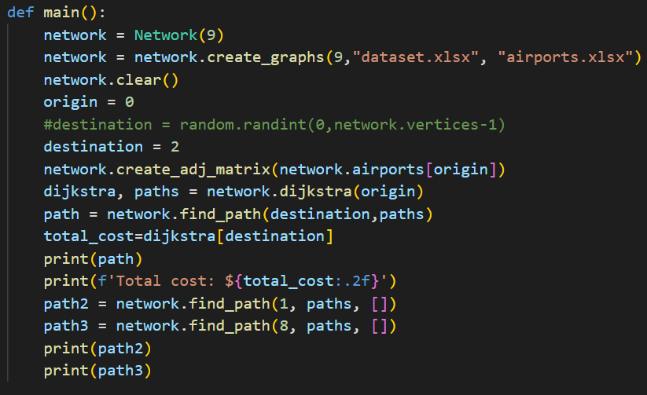
Implementation
Gather data of different flights from airports around the world
Turn data into arrays in Python using the Pandas library
Create adjacency matrix representation of Airports, with flight prices as the weighted edges
Use Dijkstra’s Algorithm to find the cheapest path from one airport to another
Compute result and display path to user

Slide 5
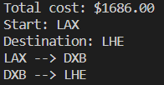
Results
Returns the cheapest combination of flights from an origin to a destination
Total Cost
Starting Airport
Destination
Path Taken

